Slide 1
IMA MARKET
PIP2001 Capstone Project
Review-1
Batch Number: IST-03
Under the Supervision of,
Prof. Srinivas Mishra
Associate Professor
School of Computer Science and Engineering
Presidency University
Roll Number | Student Name
20211IST0025 | Gana N H
20211IST0004 | Aneesh K
20211IST0015 | Azmath Patel
20211IST0018 | Rajavardhan R
Name of the Program: B.Tech in Information Science And Technology
Name of the HoD: Dr.Pallavi R
Name of the Program Project Coordinator: Prof. Srinivas Mishra
Name of the School Project Coordinators: Dr. Sampath A K

Slide 2
Content
Introduction
Literature Review
Proposed Method
Objectives
Methodology
Timeline of Project
Expected Outcomes
Conclusion
References

Slide 3
Introduction
We propose two interconnected platforms to harness India’s IT talent for national projects: the National Importance Project Portal and an E-commerce Website. The portal will act as a centralized hub, listing critical projects with detailed information on financial and technical contributions, while facilitating project tracking, collaboration, and feedback. The e-commerce website will support these initiatives by providing a marketplace for products and services related to the projects, enabling resource sharing and engagement from the community. Together, these platforms aim to address national challenges efficiently, with an initial focus on projects like the Ima Market recovery in Manipur, leveraging IT skills and resources for impactful solutions.

Slide 4
Literature Review
The development of electronic commerce applications has become increasingly significant as businesses seek to enhance their online presence and customer engagement. This paper focuses on creating a general-purpose e-commerce platform specifically for the Ima Market, which allows users to conveniently purchase traditional products from the market via the Internet. The application is designed to facilitate seamless transactions, enabling customers to search for products by name or category, add them to a shopping cart, and complete purchases using credit card transactions. Key features include a user-friendly interface for browsing products, a shopping cart for managing selections, and a wish list for future purchases. Additionally, the paper discusses potential improvements, such as developing a mobile app and integrating with local vendors to create a more interactive shopping experience. Overall, the research highlights the importance of e-commerce applications in modern retail, emphasizing their role in expanding market reach and enhancing customer satisfaction within the Ima Market community.

Slide 5
Existing method Drawback
Drawbacks of the AGRA Portal Methodology
Limited Community Participation
Resource Constraints
Data Reliability
Resistance to Change
Maintenance and Updates
Drawbacks of the E-Commerce Website Methodology
Digital Divide
Vendor Readiness
Security Concerns
Market Saturation
Dependence on Technology

Slide 6
Proposed Method
1. AGRA Portal for Flood Victims
1.1. Needs Assessment
Stakeholder Engagement
Data Collection
Requirement Prioritization
Feedback Loop
1.2. Project Listing
Project Categorization
Integration of Feedback
Administrative Tools
1.3. Transparency and Tracking
Progress Dashboard
Transparency Reports
Project Updates
1.4. Community Engagement
Collaborative Forums
Community Representatives
Regular Meetings
1.5. Resource Allocation
Data-Driven Decisions
Funding Mechanism
Impact Monitoring

Slide 7
Proposed Method
2. E-Commerce Website for Ima Market Vendors
2.1. Vendor Empowerment
Vendor Onboarding
Training Workshops
Support Channels
2.2. User Experience
User-Centered Design
Seamless
Responsive Design
2.3. Secure Transactions
Payment Gateway Integration
SSL Encryption
Transaction Monitoring
2.4. Inventory Management
Product Listing Tools
Stock Alerts
Order Management Dashboard
2.5. Community Integration
Partnerships
Promotional Campaigns
Local Stories

Slide 8
Objectives
1. AGRA Portal for Flood Victims
Needs Assessment: Gather and analyze requirements from flood victims in Ima Market to ensure that listed projects directly address their most pressing needs.
Project Listing: Develop a user-friendly interface for project administrators to create, manage, and update a diverse range of projects based on community feedback and requirements.
Transparency and Tracking: Implement features that allow flood victims to track project progress, provide feedback, and stay informed about ongoing initiatives.
Community Engagement: Foster a collaborative environment by encouraging active participation from flood victims, ensuring their voices are heard in project planning and execution.
Resource Allocation: Facilitate efficient allocation of resources and support to prioritize projects that will have the greatest impact on the community.

Slide 9
Objectives
2. E-Commerce Website for Ima Market Vendors
Vendor Empowerment: Create a platform that enables local vendors to showcase and sell their products online, enhancing their visibility and market reach.
User Experience: Design an intuitive and user-friendly interface that allows customers to easily browse, search, and purchase products from various vendors.
Secure Transactions: Ensure that the platform supports secure payment options, including credit card transactions, to build trust and encourage online shopping.
Inventory Management: Implement features for vendors to manage their inventory, track sales, and update product listings efficiently.
Community Integration: Develop partnerships with local vendors to integrate their offerings, promoting the unique cultural and traditional products available in Ima Market, thereby supporting local entrepreneurship.

Slide 10
Methodology
AGRA Portal for Flood Victims:
Stakeholder Engagement: How will you gather feedback and involve victims in decision-making?
Progress Tracking: Use of dashboards or regular reports.
Data-Driven Resource Allocation: Using data to decide how to distribute resources.
E-Commerce Website for Ima Market Vendors:
Vendor Onboarding and Training: Outline the process for getting vendors onto the platform and training them.
Secure Transactions: What technologies (like SSL encryption) will be used to secure transactions?
Responsive Design: It will help the platform adapt to different devices.

Slide 11
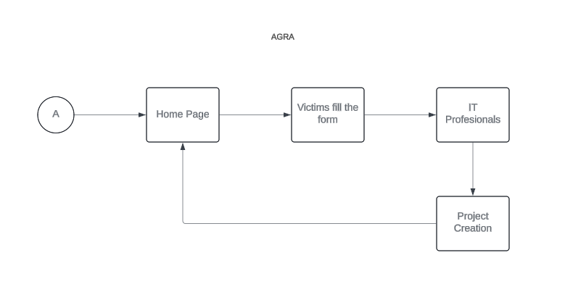
Architecture

Slide 12
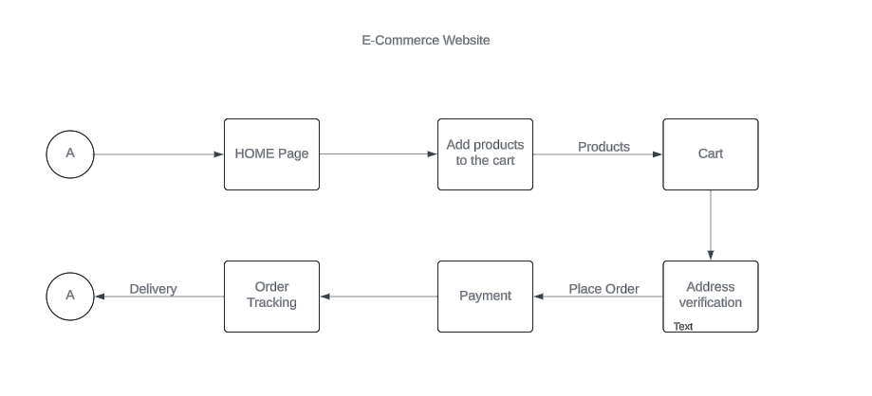
Architecture

Slide 13
Software components
1. AGRA Portal for Flood Victims
Frontend Components
HTML/CSS/JavaScript Frameworks
b. Backend Components
Web Server
Database Management System
c. APIs and Integration
PayPal, FireBase
2. E-Commerce Website for Ima Market Vendors
a. Frontend Components
HTML/CSS/JavaScript Frameworks
b. Backend Components
Database Management System
c. E-Commerce Frameworks
E-Commerce Platforms
d. Payment Processing
Payment Gateways

Slide 14
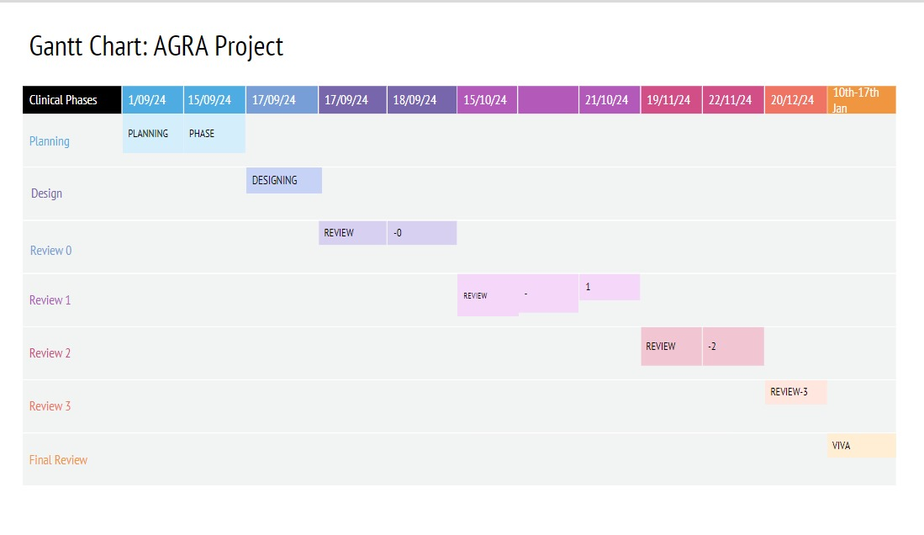
Timeline of Project

Slide 15
Expected Outcomes
The AGRA Portal enhances transparency, community engagement, and efficient resource distribution for flood relief projects. It provides real-time updates, public dashboards, and feedback mechanisms, allowing flood victims to actively participate in project planning and decision-making. Resources are allocated based on community needs, ensuring that high-impact projects are prioritized.
The E-Commerce Website empowers Ima Market vendors by expanding their reach and increasing sales through a global online platform. It offers tools for secure transactions, inventory management, and promotions, enabling vendors to manage their businesses more effectively. Additionally, it supports local entrepreneurship by providing training and digital business skills, while promoting traditional goods to a wider audience.

Slide 16
Conclusion
In conclusion, both the AGRA Portal and the E-Commerce Website offer transformative solutions tailored to address the specific needs of flood victims and local vendors in Ima Market. The AGRA Portal promotes transparency, community participation, and efficient resource distribution, empowering flood-affected communities to take an active role in their recovery. On the other hand, the E-Commerce Website enhances the market reach and sales potential of local vendors by providing them with a digital platform to showcase their products globally. It not only supports local entrepreneurship but also helps preserve and promote traditional crafts. Together, these platforms create sustainable pathways for community resilience and economic empowerment, utilizing technology to make a lasting positive impact.

Slide 17
Github Link
GitHub Link: https://github.com/Azmath-77/Ima-Market

Slide 18
References (IEEE Paper format)
Kumar, G. S., & Jose, J. T. (2017). Developing an electronic commerce platform. 2017 IEEE International Conference on Power, Control, Signals and Instrumentation Engineering (ICPCSI). https://doi.org/10.1109/icpcsi.2017.8391922
X. Tian and W. Dai, "Study on Information Management and Security of E-commerce System," 2010 International Symposium on Intelligence Information Processing and Trusted Computing, Huanggang, China, 2010, pp. 270-273, doi: 10.1109/IPTC.2010.183.
M. Khoury and S. Shirmohammadi, "Accessibility and scalability in collaborative eCommerce environments," 2007 2nd International Conference on Digital Information Management, Lyon, France, 2007, pp. 738-743, doi: 10.1109/ICDIM.2007.4444312.
M. Lingyu, C. Lauren and D. Zhijie, "Strategic Development of Fresh E-Commerce With Respect to New Retail," 2019 IEEE 16th International Conference on Networking, Sensing and Control (ICNSC), Banff, AB, Canada, 2019, pp. 373-378, doi: 10.1109/ICNSC.2019.8743243.

Slide 19
Thank You

